Slide 1
Statistics Intro

Slide 2
Outline
Background information
Summary statistics
The holy p value
Stats in practice

Slide 3

Alpha (Significance Testing)
Alpha values are the threshold we set for significance testing
Standard value is .05
< .05 = significant!
> .05 = non-significant :(
This is an arbitrary threshold

Slide 4
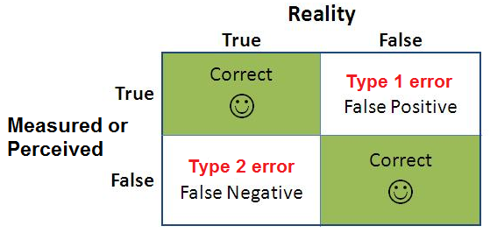
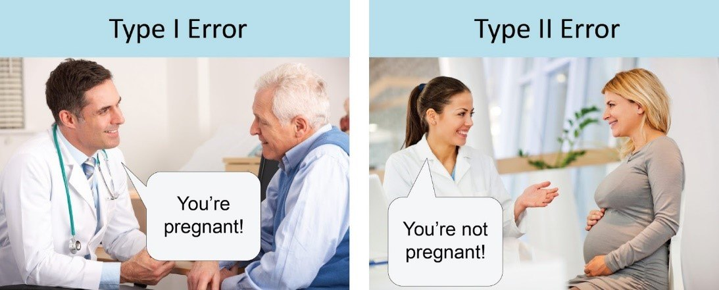
What is p actually measures
All about type 1 errors
P is saying: “how likely is is to observe this pattern of data if there is actually no effect”
By choosing alpha = .05, you are accepting a probability of a false positive = 5%
This is why some value effect size over p –values
Notes:
Type 1 error, false positive, you observe a difference, when in reality, no difference is present
Type 2 error, you observe no difference when there should be a difference

Slide 5
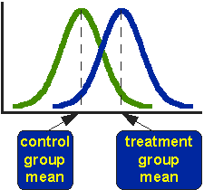
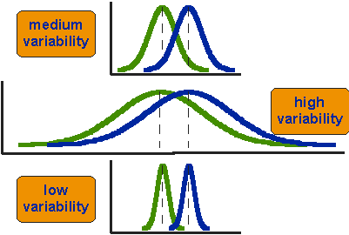
Types of Tests
T Family: Testing means between 2 conditions
Independent T-tests: comparing 2 samples
Participants complete only ONE condition
Paired t-tests: comparing 1 sample at different times
Participants complete BOTH conditions
t value – compares the means of each group, accounting for sample size and variance
Indication of magnitude
p value – indication of significance
T tests can only be used w/ 2 groups/conditions.
Figures from https://conjointly.com/kb/statistical-student-t-test/

Slide 6
Type of Tests: Analysis of Variance (ANOVA)
ANOVAs test the means of MORE than 2 conditions
One way: comparing means across 3+ groups, on one independent variable
Two way: comparing group means across 2 independent variables
0s
0.5s
1s
0s
0.5s
1s
2s
One way ANOVA with 3 levels
One way ANOVA with 4 levels
Latency
Partner
On
0s
0.5s
1s
Pre
Hu
RR
RU
Automation
Fatigue
Off
0s
0.5s
1s
Post
Hu
RR
RU
3x2 Two way ANOVA
3x2 Two way ANOVA
Hu = Human, RR = Reliable robot, RU = Unreliable robot

Slide 7
ANOVA Cont.
For a one way test:
“We observed a significant effect of latency on performance, where participants in the 0s latency condition had significantly higher performance than participants in the .5s and 1s conditions (p = .xx, M_{0s} = xx ….).”
For a two way test:
Can still report ^^^
But now, you are also testing an additional level so you can say:
“During the 0s latency condition, participants performed significantly better in the automation on condition compared to the automation off condition. No significant effect of automation were observed for .5s and 1s.”

